Slide 1
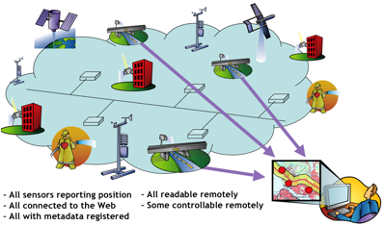
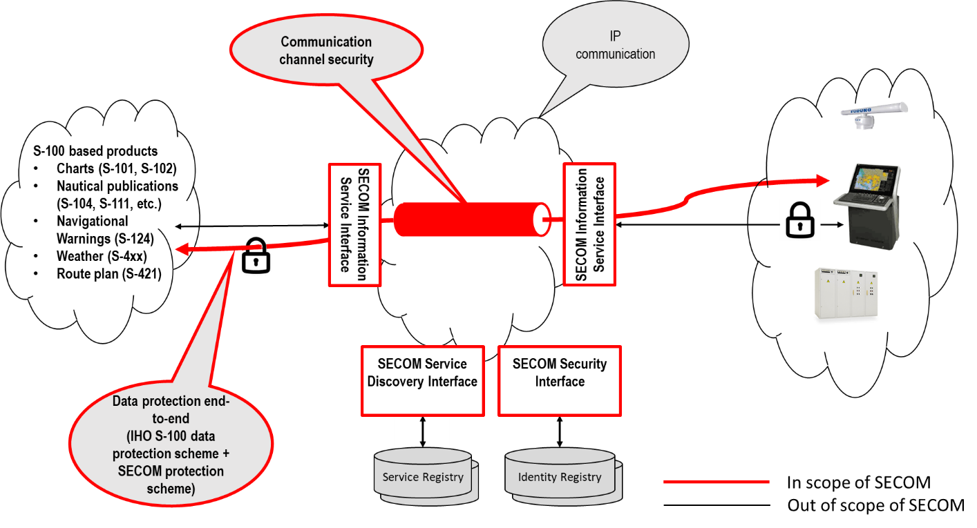
S-100 and realtime data - approach
The Challenge
Implementing changes to S-100 to specifically address the requirements of realtime data exchange
Modifying S-100’s data encoding/streaming to enable easier integration with external frameworks.
Make necessary adjustments for the chatracteristics of realtime data
Focus on:
How data models can be aligned
Specifying requirements for API based transfer of data
Two candidate models for packaging realtime data, ISO63173-2 SECOM and OGC Sensor Web Enablement (SWE) framework.

Slide 2
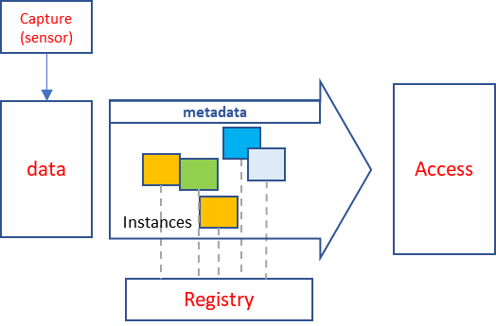
Focus on modifications to S-100 parts to complement external frameworks, without rewriting them
Frameworks also under development
“Standalone” (features, portrayal, quality etc)
Enabled API access
Key use cases in existing product specifications and maritime services
Proposal to edit:
Part 10b (GML Profile)
Part 14 Data streaming
Guidance for Product Specification developers
Demonstrate with use cases
Include bandwidth limited use cases

